Slide 1
Bail Bond Project
Hannah Laper
Venkatesh Rudrappa
Tara Bhardvaj

Slide 2

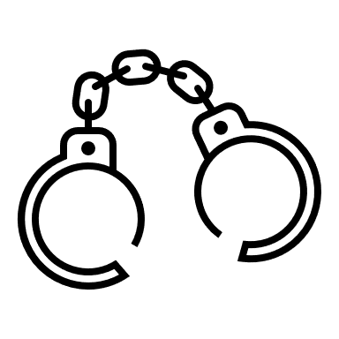




What is Bond?
Bail, or bond, refers to the fee or condition by which someone who has been arrested is allowed to leave jail as they await a trial or hearing. (ABA)
Bail is determined at arraignment which is when the charges are first read, and bail is set.
Bail can be revised at a bail hearing which is held after an arraignment. A defendant can have multiple bail hearings.
Bail
Transfer to jail
Arrest
No Bond
Bail Hearing
Preliminary Hearing
Arraignment

Slide 3
How is Bail Determined?
Bail is determined using the following factors:
Risk of defendant returning to court
Danger to community
Type of Alleged Crime
Likelihood of defendant fleeing
Bail Amount is determined by affordability ( in some jurisdictions), along with deterrent factor
NMR conditions are determined using facts of case and granted in cases where they are likely to be followed.
https://www.americanbar.org/groups/public_education/resources/law_related_education_network/how_courts_work/bail/

Slide 4
Release Decisions
Remanded/ Held Without Bond
Released on Bond
Released on Non-monetary conditions
Released on Recognizance

Slide 5
Research questions
Can we predict whether bail will be set?
Can we predict the bail amount?
Can we predict the nonmonetary bail conditions?

Slide 6
Dataset
NYC Pretrial Release data
Source: NY Courts. Gov
https://ww2.nycourts.gov/pretrial-release-data-33136
Shape: (283034, 108)
Date Range: 1/1/2018 – 6/30/2021
Fields: Race, Gender, Age, Release Decision, Bond Amount, prior offenses

Slide 7
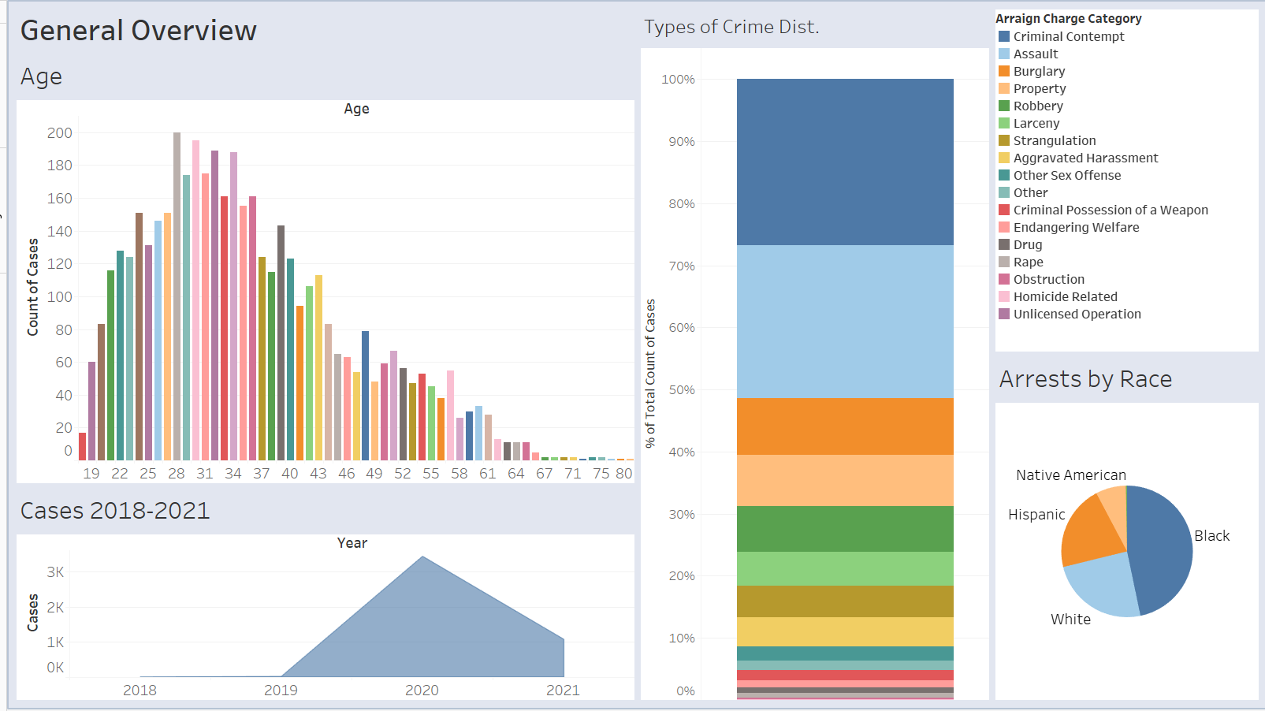
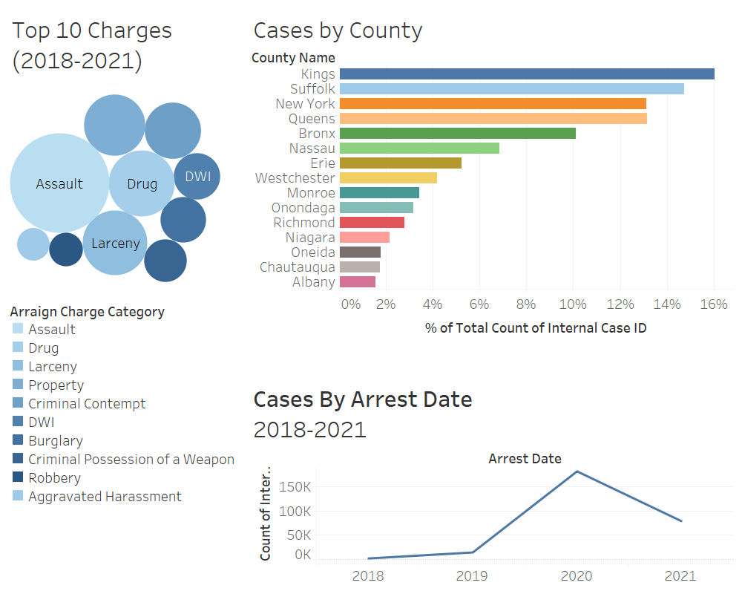

Slide 8
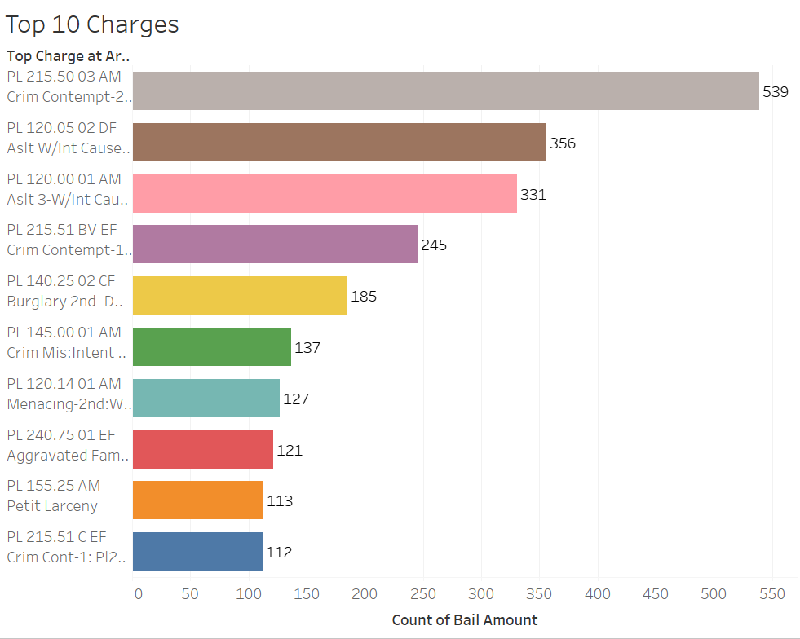
Top 10 Charges

Slide 9
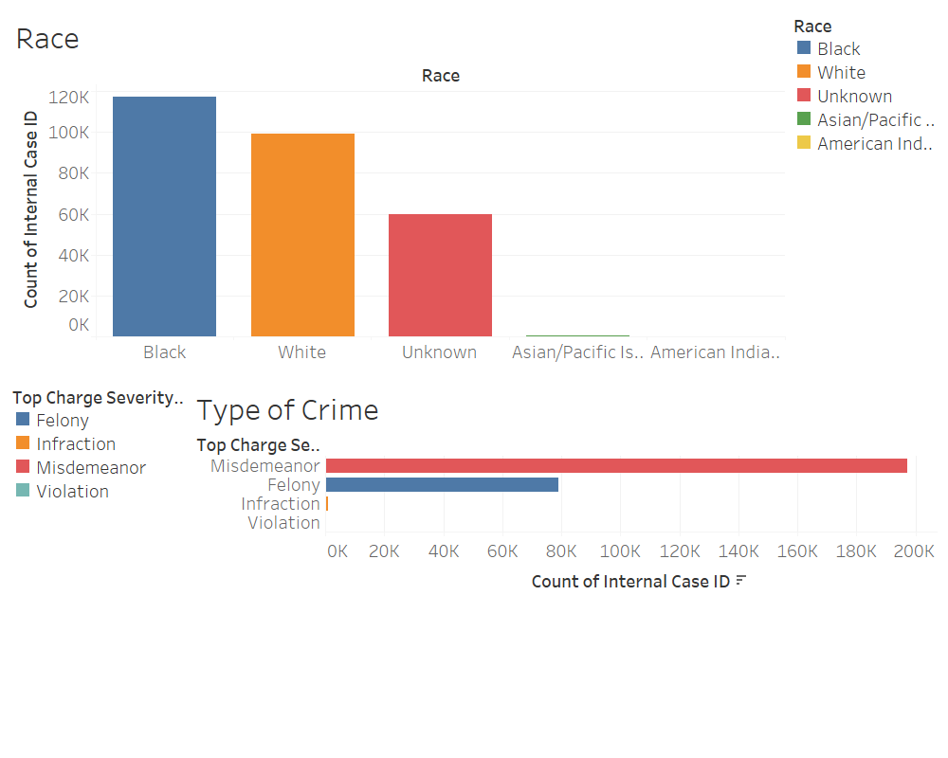
Demographics

Slide 10

Predicting if bail will be set

Slide 11
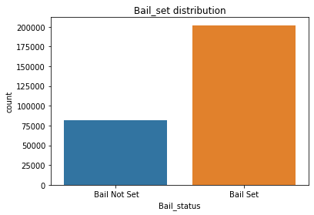
Bail Set Distribution

Slide 12
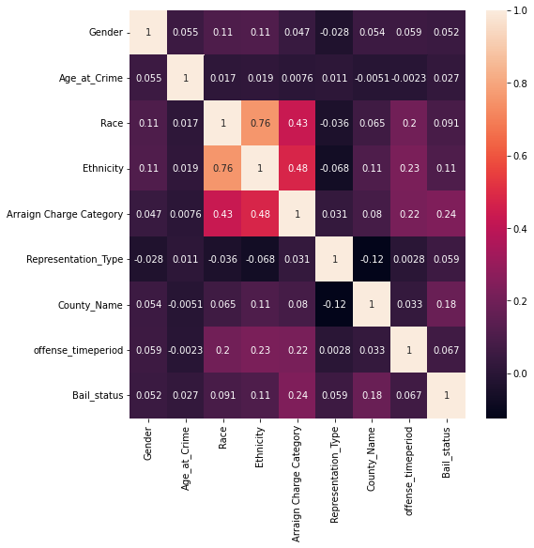
Heatmap

Slide 13
Baseline Model
Normalize the dataset to have same scaling
Split the tidy data as test and train 30% and 70% respectively
Fed the baseline model with the test and train dataset to have base accuracy score
Accuracy Score from Baseline Model: 71.18%

Slide 14
Logistic Regression
Accuracy: 0.7248589095261003
F1 Score: 0.8303502958922345
Precision: 0.7394217389063547
Recall: 0.9467779720856567
4391 | 20224
3226 | 57388

Slide 15
Gaussian Naive Bayes Model
Accuracy: 0.7104154689131633
F1 Score: 0.8173360865028085
Precision: 0.7411513630323611
Recall: 0.9109776619262877
5330 | 19285
5396 | 55218

Slide 16
k-Nearest Neighbors Classifier Model
Accuracy: 0.7639418507784909
F1 Score: 0.8438511389654236
Precision: 0.7967492781873342
Recall: 0.8968720097667205
10747 | 13868
6251 | 54363

Slide 17
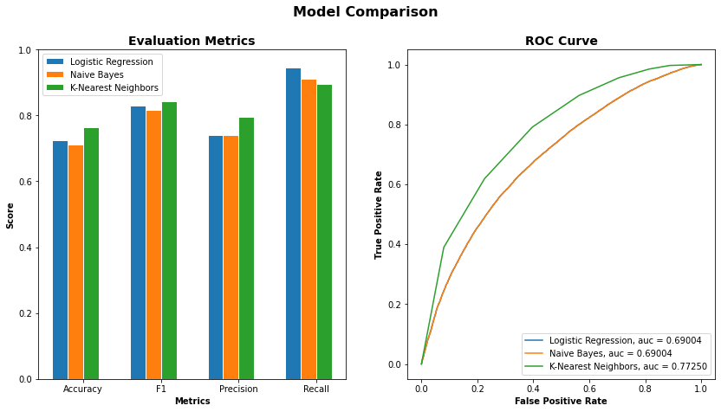

Slide 18
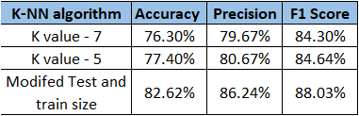
Modelling after parameter tuning
sfbs

Slide 19
Predicting Bail Amount

Slide 20
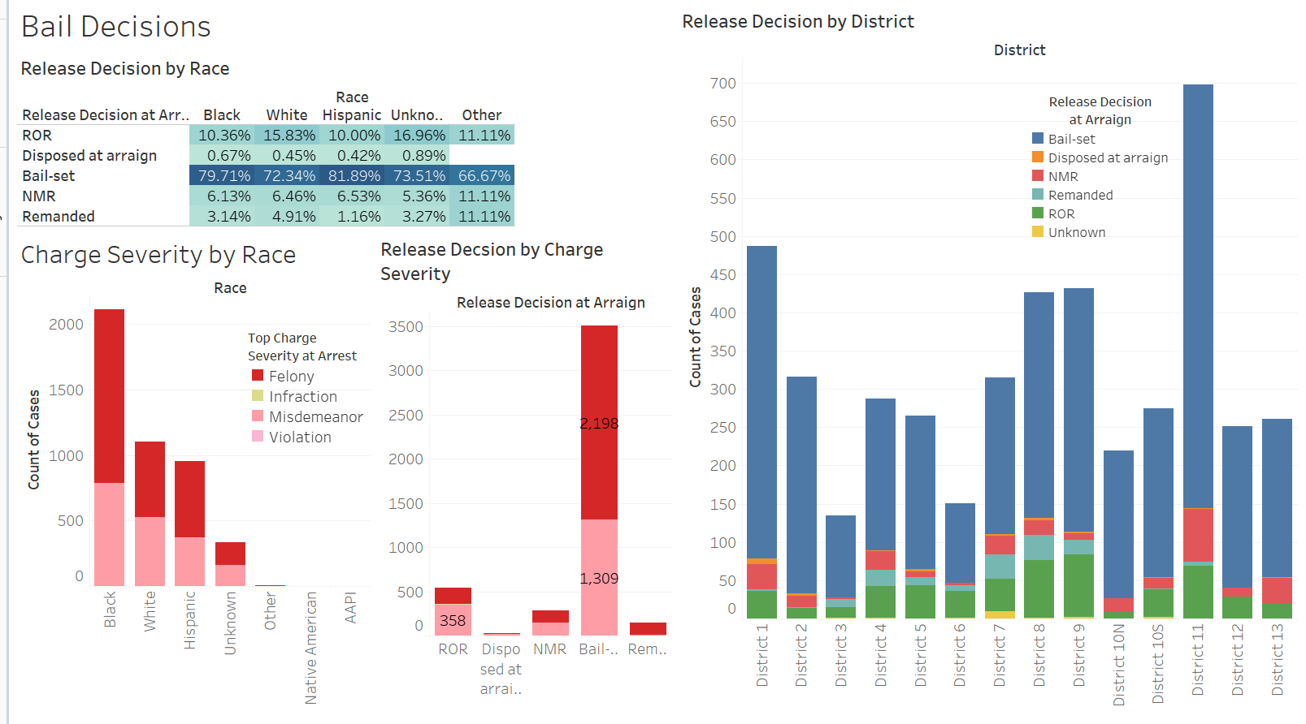

Slide 21
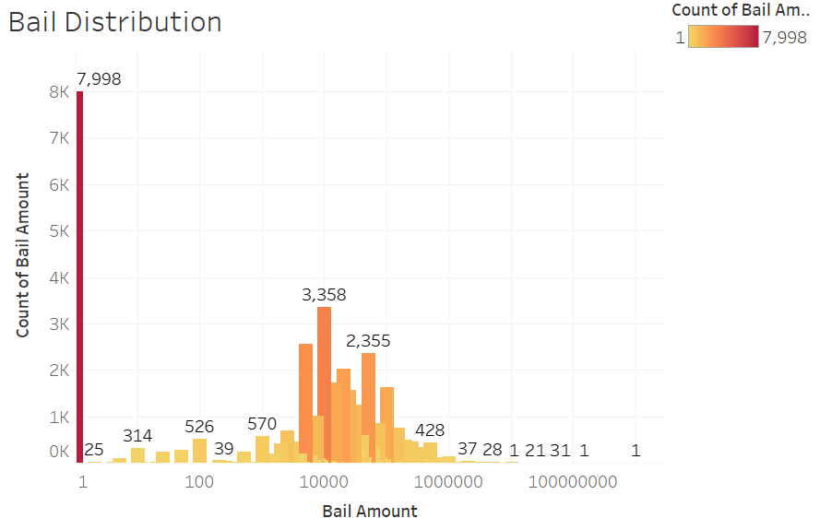
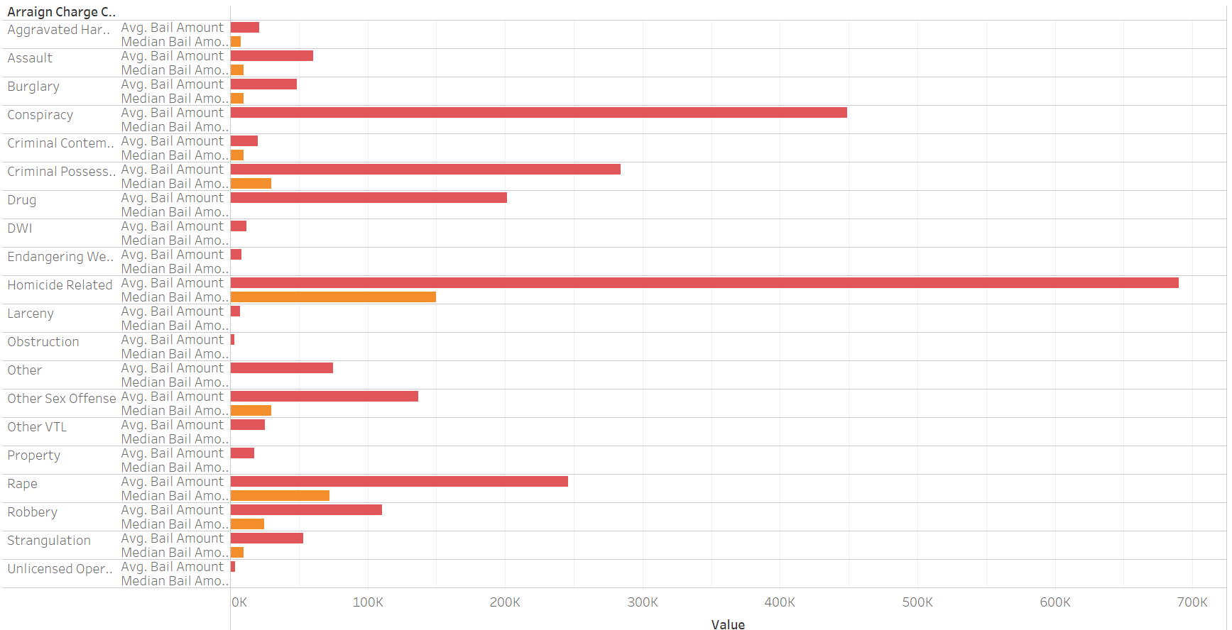
Bail Amount Distribution

Slide 22
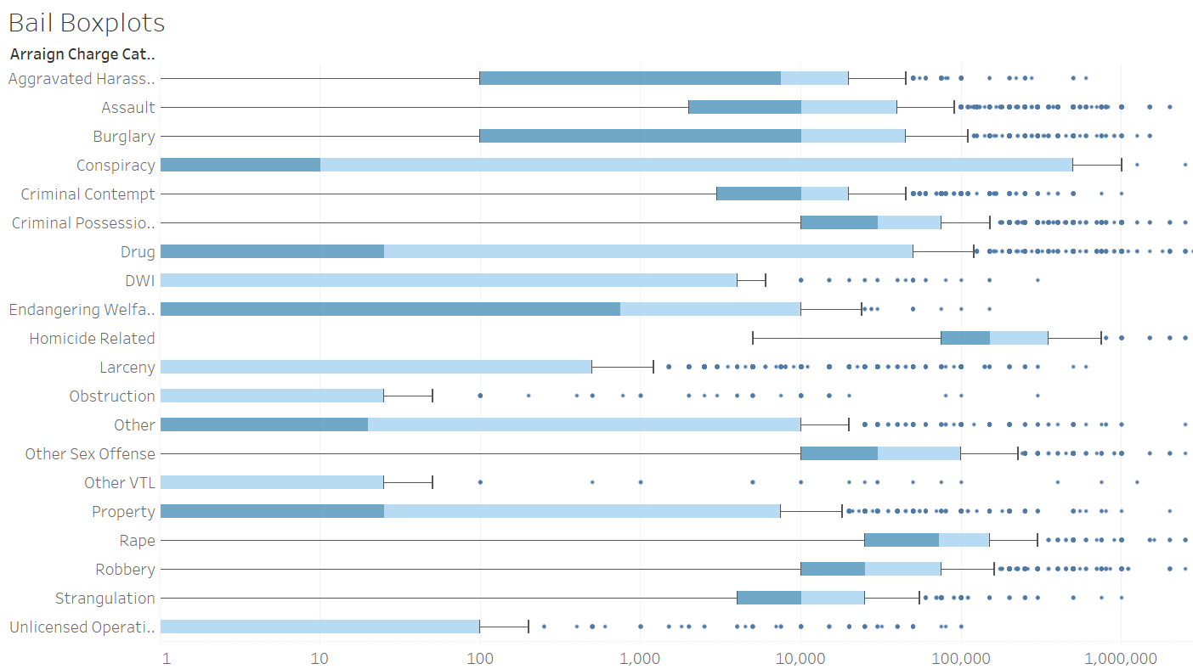

Slide 23
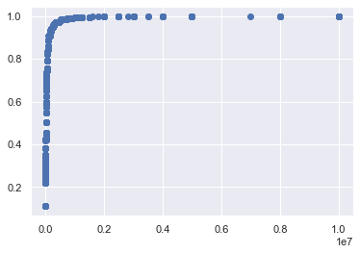
Bail Amount vs. Bail Percentile

Slide 24
Linear Regression Models
Model 1:
Features: Crime, Race, Gender, Prior offenses, Age, Pretrials attended, Court ORI
R2: -220075292403263.6
MSE: 17912596437822.797
Model 2:
Features: Crime, Race, Gender, Court ORI,
R2: -1.3255014694133315e+22
MSE:1.103056599217445e+21 r2

Slide 25
Decision Tree Regressor
Model 1:
Features: Crime, Race, Gender, Prior offenses, Age, Pretrials attended, Court ORI
R2: 0.17
MSE: 0.06718
Model 2:
Features: Crime, Race, Gender, Court ORI,
R2: 0.4411
MSE: 0.04568

Slide 26
K Neighbors Regression
Model 1:
Features: Crime, Race, Gender, Prior offenses, Age, Pretrials attended, Court ORI
R2: 0.4407
MSE: 0.04557
Model 2:
Features: Crime, Race, Gender, Court ORI,
R2: 0.4525
MSE:0.04555

Slide 27
SVR
Model 1:
Features: Crime, Race, Gender, Prior offenses, Age, Pretrials attended, Court ORI
R2: 0.5372
MSE: .03767
Model 2:
Features: Crime, Race, Gender, Court ORI,
R2: 0.5190
MSE:0.0401

Slide 28
Logistic Regression (Classification Model)
Recall Score: 0.5045612114577632
F1 Score: 0.49323880937036235
Precision Score: 0.49304877929031826
Accuracy Score: 0.5045612114577632

Slide 29
Predicting Non monetary Bail Conditions

Slide 30
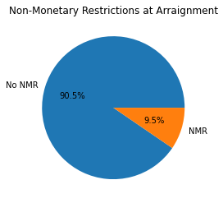
Percentage of NMR cases

Slide 31
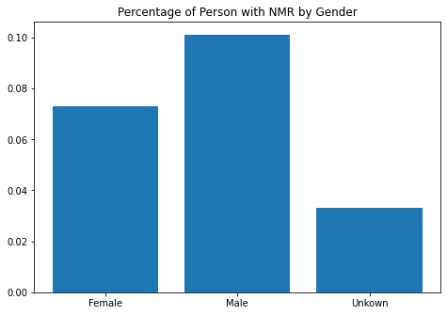
NMR By Gender

Slide 32
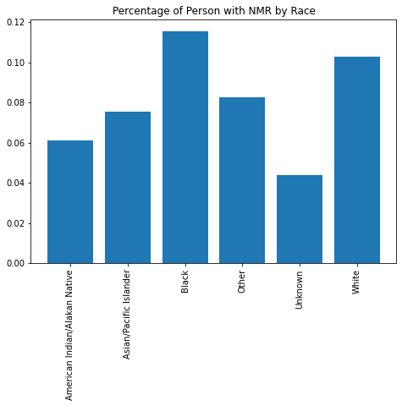
NMR By Race

Slide 33
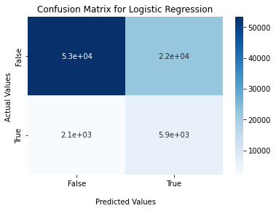
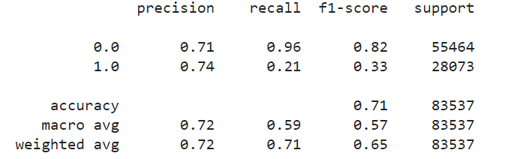
Logistic Regression

Slide 34
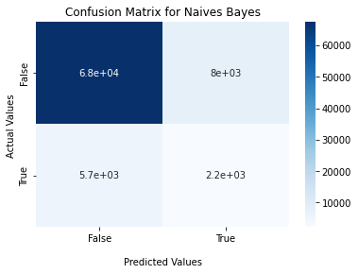
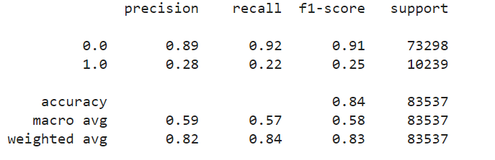
Naïve Bayes

Slide 35
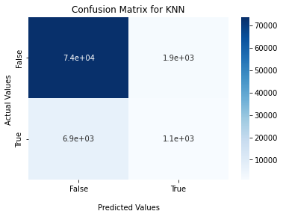
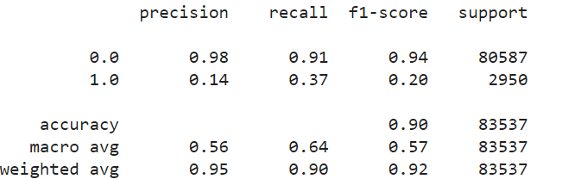
KNN

Slide 36
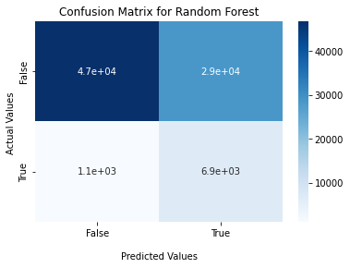
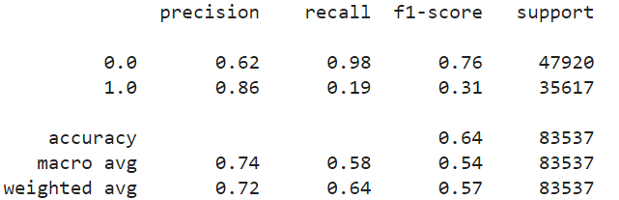
Random Forest

Slide 37
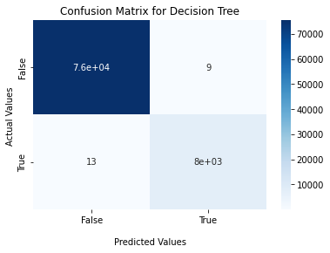
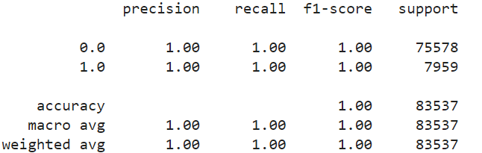
Decision Tree

Slide 38

Neural Network
Epochs: 10
Relu > Relu> sigmoid activation
Test accuracy: 0.9048

Slide 39
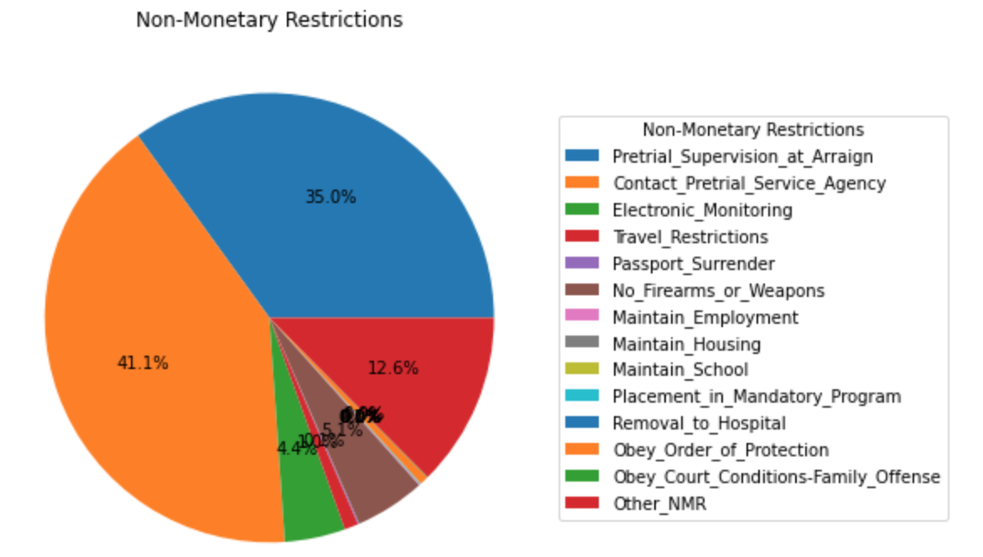
Percentage of NMR Conditions

Slide 40
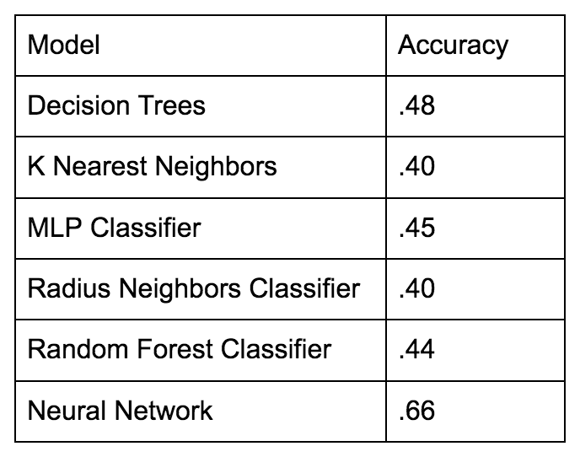
Multi-Output Classification Models
*Neural Network: Epochs = 50; ReLu>ReLu> sigmoid activation

Slide 41
Conclusion
We can model whether people receive Bail using classification models.
We can model the likelihood of receiving an NMR release however it is difficult to predict what conditions may be imposed.
We cannot reliably model bail amounts without more information. Bail amounts range from $1 to $1 Billion.
The next steps of this project would be to create an interface that people could interact with to predict bail.

Slide 42

Questions, Comments, Concerns

Slide 43
